Slide 1
BLOCKCHAIN EHR

Slide 2
ABSTRACT
We present a framework that could be used for the implementation of blockchain technology in healthcare sector for EHR.
The aim of our proposed framework is firstly to implement blockchain technology for EHR and secondly to provide secure storage of electronic records by defining Chain access rules for the users of the proposed framework.
Moreover, this framework also discusses the scalability problem faced by the blockchain technology in general via use of off-chain storage of the records.
This framework provides the EHR system with the benefits of having a scalable, secure and integral blockchain-based solution.

Slide 3
DOMAIN INTRODUCTION
A blockchain is a growing list of records called blocks, that are linked using cryptography.
Each block contains a cryptographic hash of the previous block and a timestamp.
It is resistant to modification of the data

Slide 4
LITERATURE SURVEY
SURVEY | AUTHOR | YEAR | EXPLANATION
SURVEY 1: Electronic Health Record System using Blockchain | B.Harshini | 2020 | The data is encrypted by the algorithm known as SHA-256 which is used to encrypt all the data of the patients into a single line 256 bit encrypted text. Cons: : Less Secure due to its 256 Standards
SURVEY 2: Electronic Health Records using Blockchain Technology | Arlindo F. da Conceic¸ao | 2019 | propose the implementation of a large-scale information architecture to access Electronic Health Records (EHRs) based on Smart Contracts as information mediators. Cons: : Health Record validation delay and false sense of security
Survey 3: Analysis of Blockchain in the Healthcare Sector: Application and Issues | Dsv madala etal.,,, | 2022 | o investigate how blockchain technology can be applied to improve the overall performance of the healthcare sector Cons: low scalability and less transaction

Slide 5
LITERATURE SURVEY (CONT…)
SURVEY | AUTHOR | YEAR | EXPLANATION
SURVEY :4 Electronic health records and blockchain interoperability requirements: a scoping review | Suzanna Schmeelk | 2022 | We conducted a literature search in the OVID databases (Medline and Embase) on terms blockchain, implementation, interoperability, EHRs, security, and standards. Cons : False sense of security due to frequent Database.
SURVEY 5: Blockchain-based Electronic Health Records Management A Comprehensive Review and Future Research Direction | Mamun, Abdullah Al | 2022 | The study examined 99 papers that were collected from various publication categories. The deep technical analysis focused on evaluating articles based on privacy, security, scalability, accessibility, cost, consensus algorithms. Cons: No Specific solution proposed to overcome the issues.

Slide 6
Existing System
Medical data intervention is always possible because the existing system is a centralized distributed system.
In the existing system there are drawbacks such as no data privacy, less reliability and lack of network security in sharing the health record among the cloud servers.
Also failure in single point can happen in existing system which results in unavailability of data.
It also lacks in data retrieval process since the existing system faces storage issues
Disadvantages of existing system:
In a centralize communication model, the system administrator may disclose sensitive data due to insider attacks
Several large-sized distributed data centers which creates a huge burden for computing, storage, and networking resources

Slide 7
PROPOSED SYSTEM
In the proposed blockchain technology based EHR provides decentralized system.
This proposed system provides trustworthy access control mechanism by using the smart contracts in order to achieve secured EHR sharing between the patients and the health care providers including hospital and pharmacist.
In the proposed system, a patient can register and feed his details regarding health which then will be converted into hash value using SHA 512 algorithm and then it will be embed to a EHR Data.
Using this hash value the doctor and the hospital can view the details permitted by the patients.

Slide 8
PROPOSED SYSTEM
The doctors can now provide the medicines by viewing the patients record and this will be converted into a block.
This block can be viewed by pharmacist and automatically invoice will also be created.
This proposed system also integrates crypto currency that is ethereum which preserves sensitive health information against threats.
The crypto currency can also be used to book a doctor's appointment and also pay for it.

Slide 9
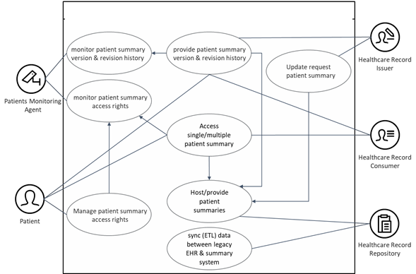
PROPOSED SYSTEM ARCHITECTURE

Slide 10
ADVANTAGES OF PROPOSED SYSTEM
By using the unmodifiable property of blockchain provide more security.
Confidentiality is transparent with each transaction visible to all the peers.
Run a application in offline mode.
Certificate is validated rapidly.
Provide accurate and reliable information

Slide 11
SYSTEM SPECIFICATION
HARDWARE SPECIFICATION
Processor : I3 Processor above
Ram : 4 Gb.
Hard Disk : 500 GB.
Input device : Standard Keyboard and Mouse.
Output device : VGA and High Resolution Monitor.
SOFTWARE SPECIFICATION
Operating System : Windows.
Programming Language : Python and Java
IDE : Anaconda IDE

Slide 12
REFERENCES
[1] J. Huang, C. C. Xing, S. Y. Shin, F. Hou, and C. H. Hsu, “Optimizing m2m communications and quality of services in the iot for sustainable smart cities,” IEEE Transactions on Sustainable Computing, vol. 3, no. 1, pp. 4–15, Jan 2018.
[2] Amy Nordrum, “Popular Internet of Things Forecast of 50 Billion Devices by 2020 Is Outdated,” Accessed: 2018-05-31. [Online]. Available: https://spectrum.ieee.org/tech-talk/telecom/internet/popularinternet-of-things-forecast-of-50-billion-devices-by-2020-is-outdated
[3] E. Luo, M. Z. A. Bhuiyan, G. Wang, M. A. Rahman, J. Wu, and M. Atiquzzaman, “Privacyprotector: Privacy-protected patient data collection in iot-based healthcare systems,” IEEE Communications Magazine, vol. 56, no. 2, pp. 163–168, Feb 2018.
[4] J. Pan and J. McElhannon, “Future edge cloud and edge computing for internet of things applications,” IEEE Internet of Things Journal, vol. 5, no. 1, pp. 439–449, Feb 2018.
[5] H. Sun, Z. Zhang, R. Q. Hu, and Y. Qian, “Challenges and enabling technologies in 5g wearable communications,” CoRR, vol. abs/1708.05410, 2017.

